Slide 1

Speech Emotion Recognition using Machine Learning
AI Development Program
Technion – Israel Institute of Technology
Netanel Mazuz • Yizhar Goldstein • Victor Melichov

Slide 2
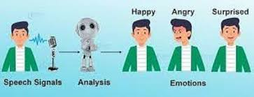

The Problem
Motivation:
As human beings speech is amongst the most natural way to express ourselves. We depend so much on it that we recognize its importance when resorting to other communication forms like emails and text messages where we often use emojis to express the emotions associated with the messages. As emotions play a vital role in communication, the detection and analysis of the same is of vital importance in today’s digital world of remote communication.
Problem:
Most humans have the natural abilities to recognize emotions from speech, but the problem is that in today’s digital world we need computers to do that job for us for many reasons. Human machine interaction is widely used nowadays in many applications. One of the medium of interaction is speech. Emotion can play an important role in decision making. If emotion can be recognized properly from speech then system can act accordingly.

Slide 3





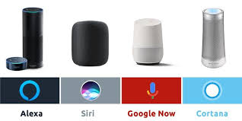


Applications
Customers satisfaction in Call Centers
Job satisfaction in Businesses and Corporations
Suicide prevention in social media and violence detection
Voice and Mental assistance

Slide 4

Solution and Target
Our mission is to find out a classic machine learning multi-class classifier model to recognize the emotion type from audio speech sample
Recognition of basic emotion types for general purposes:
Neutral, Happy, Sad, Fear, Disgust, Angry, Surprise
We need to find a Dataset that has all of these emotion types in as many variations as possible, with different gender, pitch, accent, age, sentences and clarity
Our expectation target, is comparable to a referenced best projects in Kaggle:
Project | Model | Score
Kaggle project 1 | Neural Network | 95%
Kaggle project 2 | SVM | 61%
Our project target | Random Forest | 70-80%

Slide 5
Data Sets

Slide 6
Data info
 | RAVDESS | TESS | CREMA-D | SAVEE
Actors | 12 Male, 12 Female | 2 Female | 48 Male, 43 Female | 4 Males
Ages | Unspecified | 26, 64 | 20-74 | 27-31
Lexical statements | 2 | 200 | 12 | 15
Accent | Neutral North American | Unspecified | African America, Asian, Caucasian, Hispanic, Unspecified | English
Emotion types | neutral, calm, happy, sad, angry, fearful, surprise, disgust | anger, disgust, fear, happiness, pleasant surprise, sadness, neutral | Anger, Disgust, Fear, Happy, Neutral, Sad | anger, disgust, fear, happiness, sadness surprise, neutral
Emotion intensity | normal, strong | Unspecified | Low, Medium, High, Unspecified | Unspecified
Total samples | 1440 | 2800 | 74420 | 480

Slide 7
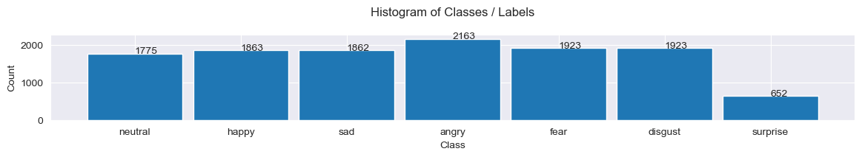
Class labels Histogram
Neutral and Calm emotion are difficult to recognize, thus they were merged
All emotions now has almost the same amount, despite Surprise
How did we deal with the imbalanced data?
First, we duplicated the Surprise class on all data, but we got test leakage
Duplication in train set increases the computation time.
Instead of duplication or weighting, we used CrossValidation with StratifiedKFolds, for balance training of data

Slide 8
System Pipeline

Slide 9
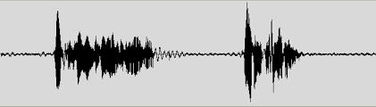

System Block Diagram
Speech Audio Dataset
Pre-processing
Training Samples
Test Samples
Augmentation
Features Extraction
Features Extraction
Training Classifier Model
Model Prediction
Emotion Recognition

Slide 10
Data Augmentation
Adding uniform background noise to speech sample
Shifting the speech sample in time
Shifting the pitch in speech sample
Strech the speech sample
Train Data Collection
Train data speech sample
Features Extraction
Augmentation

Slide 11
Speech Signals

Slide 12
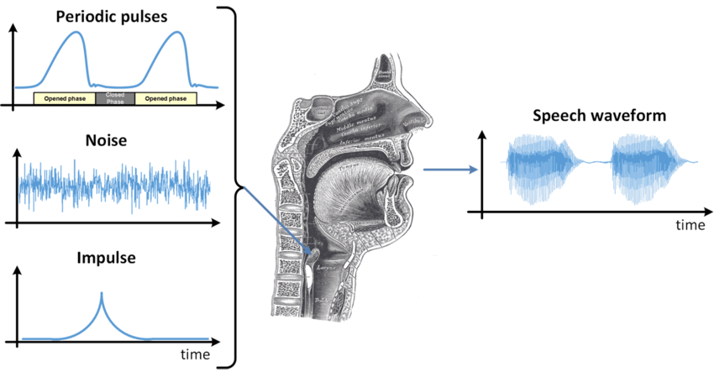
Speech Analysis
Vocal tract
Glottal pulses
Lip radiation

Slide 13

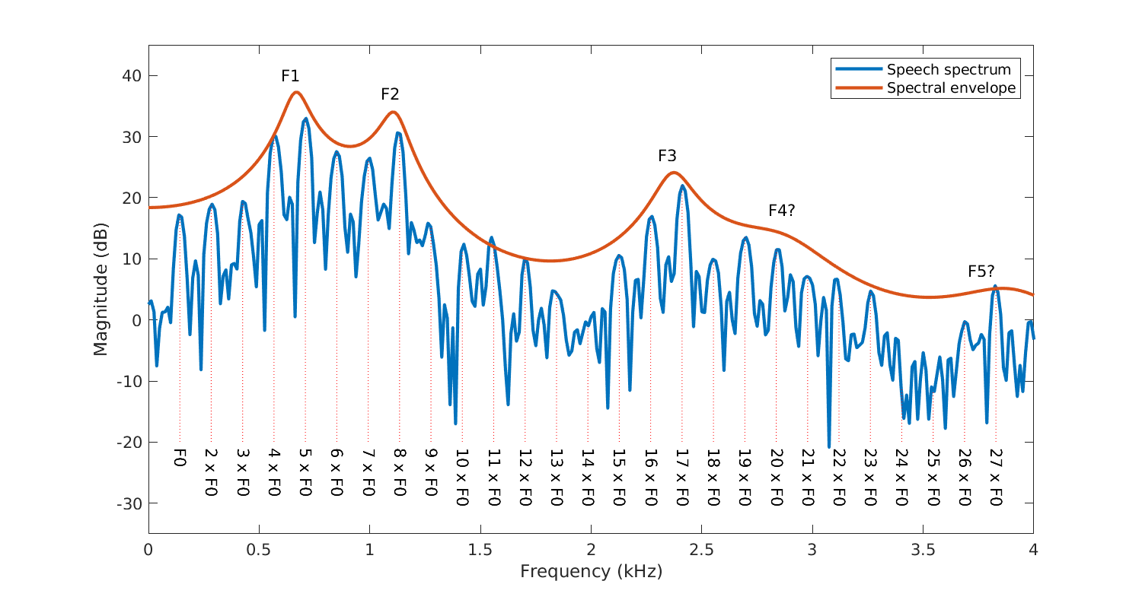
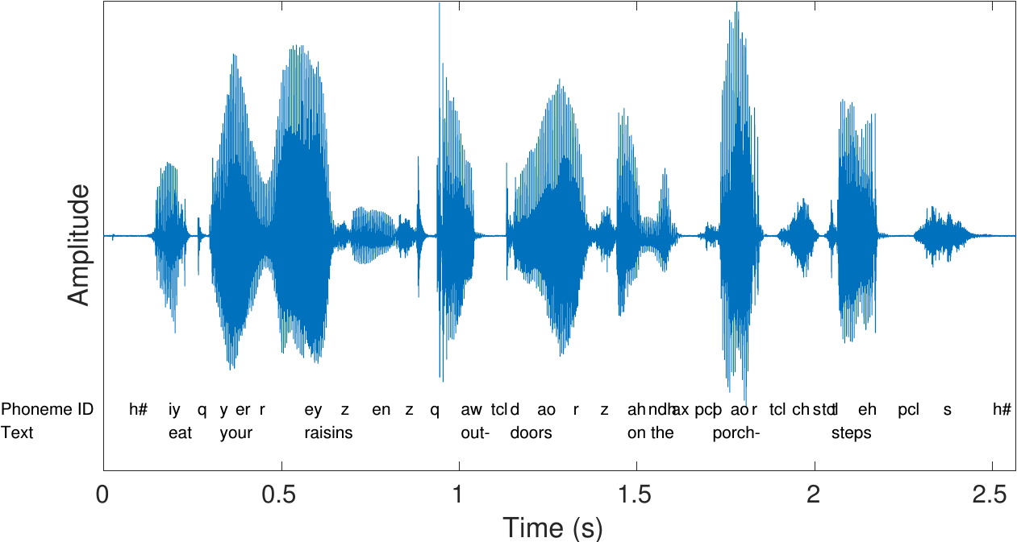
Speech Analysis
Speech Waveform
Speech Spectrum

Slide 14
Audio Features
Low Level Features |  | Middle Level Features | High Level Features
Time Domain Features | Amplitude Envelope | pitch | gender
 | RMS – Root Mean Square | beat | age
 | ZCR – Zero Crossing Rate | rhythm | accent
 | Tempogram | tempo | intonation
Time-Frequency Domain Features | Mel Spectrogram | loudness | mood
 | MFCC – Mel Frequency Cepstral Coefficients | tempra
 | Spectral Centroid, Bandwidth, Contrast, Flatness, Rolloff

Slide 15
Feature Extraction

Slide 16
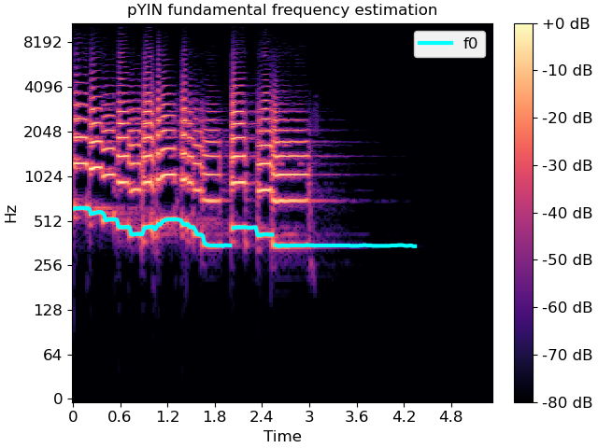
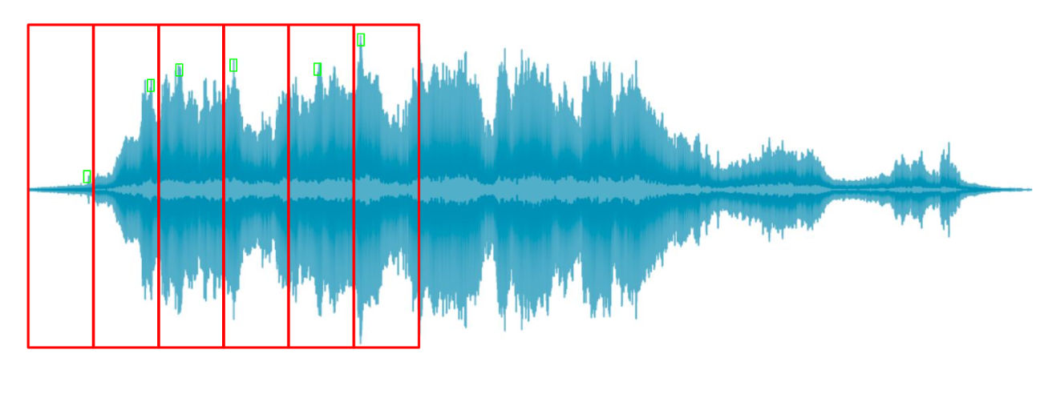
Features Extraction – Domain Knowledge
Windowing short time frames with overlap, and transform each frame to frequency domain with STFT – Short Time Fourier Transform:
As a result, we got a spectrogram – a 2-dimentional view of audio, while X-axis is a time frames, and Y-axis is frequency representation of each frame in logarithmic magnitude.
A blue curve – is the highest frequency harmonic variating in time – the Spectral Centroid.

Slide 17
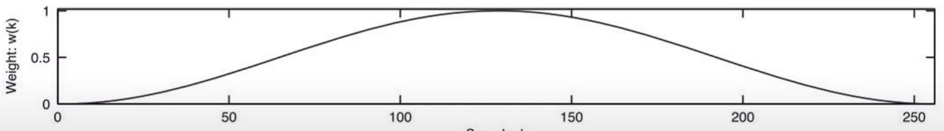
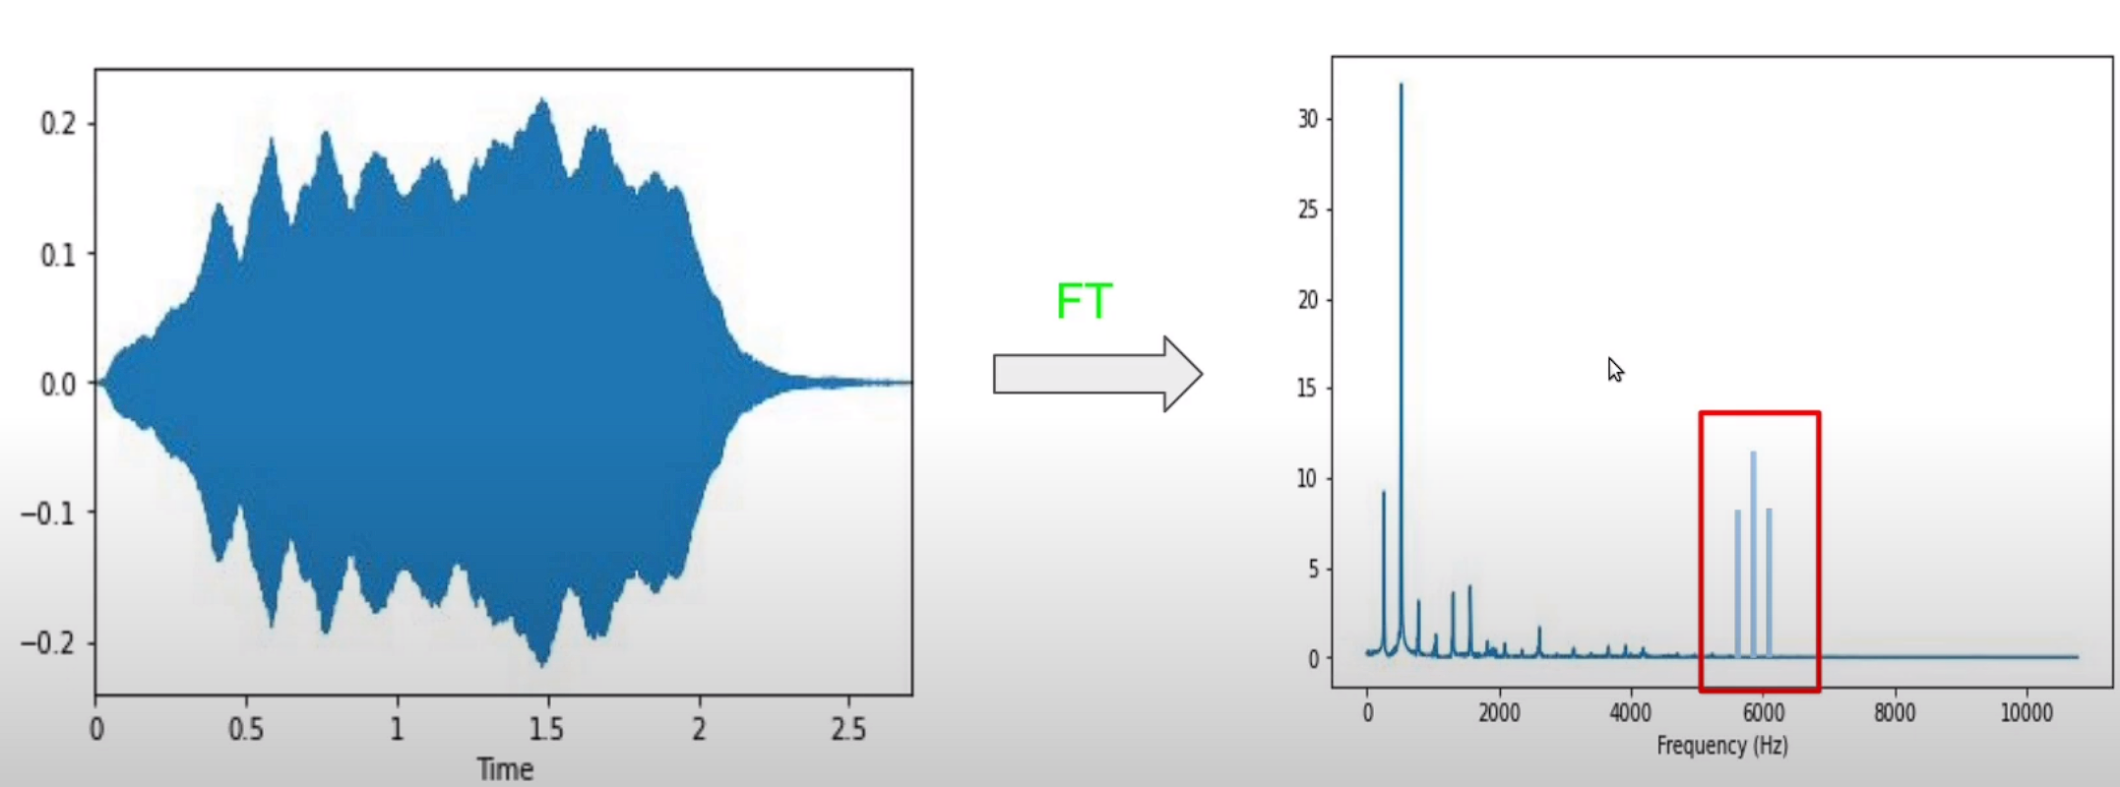
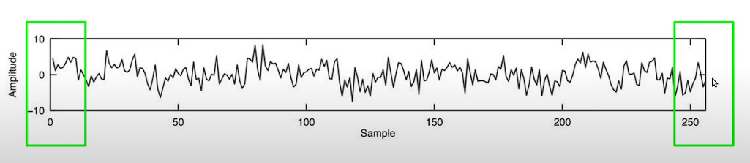
Features Extraction – Domain Knowledge
Spectral Leakage: Frequency content of a signal "leaks" into adjacent frequency bins during spectral analysis, when applying the DFT or FFT to a signal. It arises due to the finite length of the signal being analyzed, which introduces discontinuities at the signal boundaries. When a signal is segmented into finite-length windows, the signal appears to have discontinuities at the edges of the window, leading to spectral leakage.
Spectral leakage manifests as spreading of spectral energy from the main spectral peak into neighboring frequency bins, which can distort the spectral representation of the signal.

Slide 18

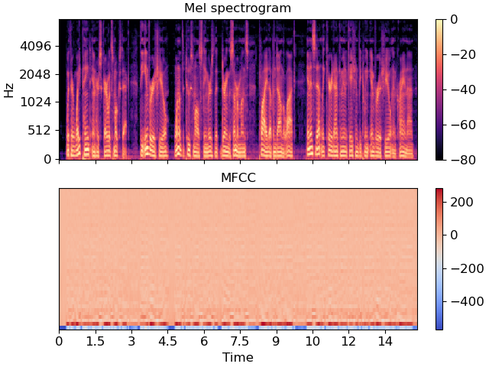
Features Extraction – Domain Knowledge
We use Librosa library for audio processing.
Main features:
RMS, ZCR, Mel-spectrogram, MFCC, Spectral Centroid, Spectral Bandwidth, Spectral Contrast, Spectral Rolloff
Delta features:
Delta, Delta-delta of all of features above
Statistical features:
Mean, Variance, Sum, Min, Max, Argmax of all of features above
Selected Features:
Mean, Min, Max of MFCC features

Slide 19
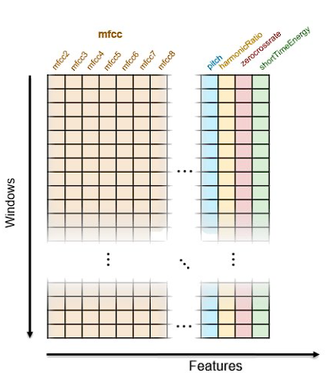
Features Extraction – Domain Knowledge
A single is given in time domain, we use Librosa library methods to extract features in the frequency domain.
We divide each signal into small intervals/windows and execute those transformations on each window individually.
Eventually, we use mean, min, max on all the windows of the same signals to reduce the number of total features.

Slide 20
Feature Extraction - MiniRocket
ROCKET- transforming input time series using random convolutional kernels and using the transformed features to train a linear classifier.
MINIROCKET– a much faster, less random version of ROCKET.
ELEMENTS:
Kernels of fixed length of 9, consisting of fixed weights of 𝛼 = −1 and 𝛽 = 2. Kernel total weight is 0. Thus, there are 84 possible kernels.
PPV - proportion of positive values
Dilation - Dilation is used to ‘spread’ a kernel over the input.

Slide 21
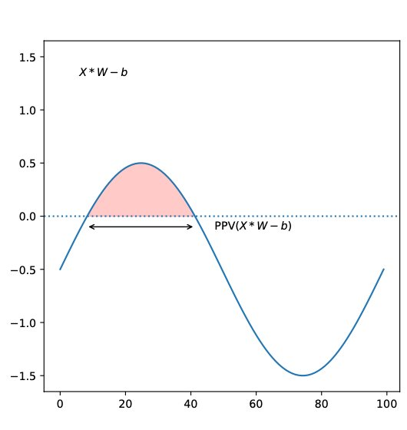
Feature Extraction - MiniRocket
PPV
We used ~10k Kernels on our input.
It resulted in about ~10K features.

Slide 22
Feature Extraction - Scatter Transform
Yet another method to extract features from a time series input using convolution.
We decompose the input using wavelets.
Filtering input using a wavelet divides input to low pass frequencies and high frequescies by the wavelet.
Wavelets divide the signal into different frequency components, which make it similar to FFT.
Wavelet
LPF
HPF

Slide 23
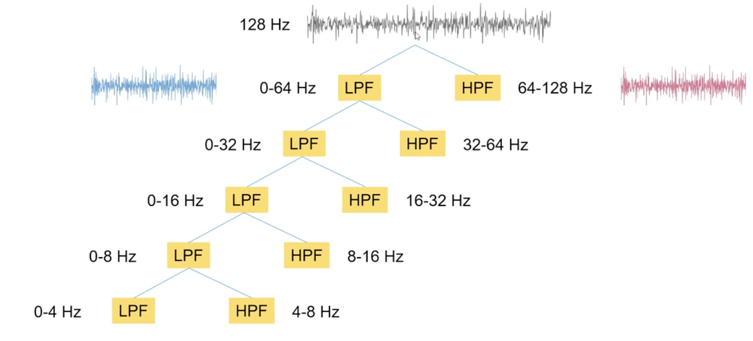
Feature Extraction - Scatter Transform
Wavelet decomposition

Slide 24
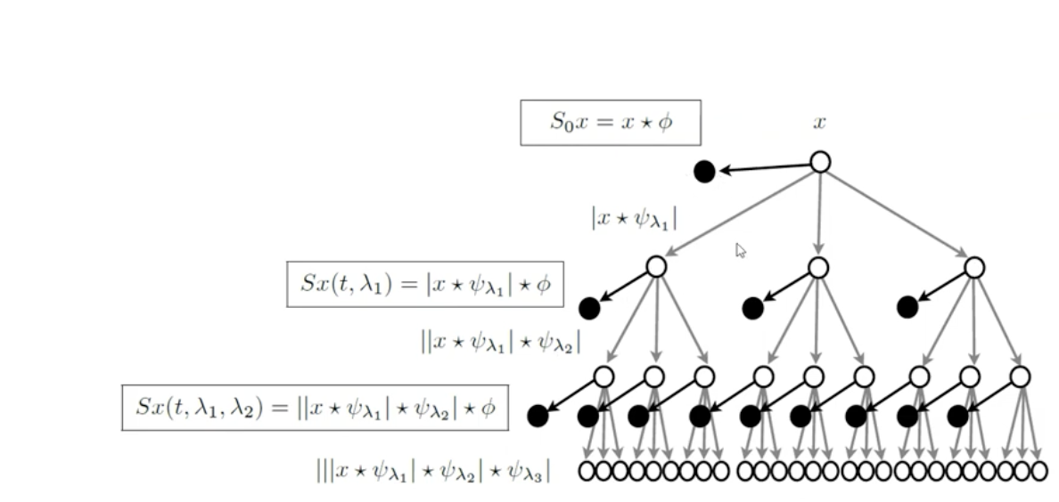
Feature Extraction - Scatter Transform

Slide 25
Feature Reduction

Slide 26
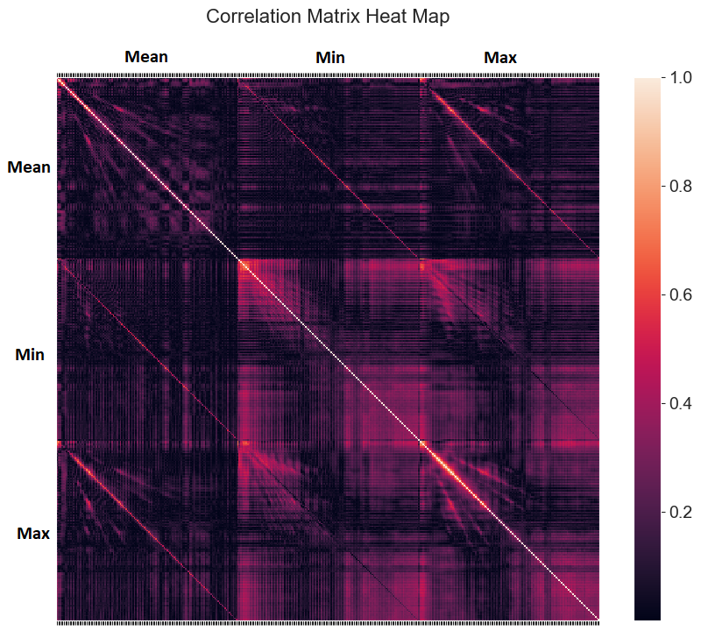
Feature Analysis
We have total 384 features (128x3)
There is no practical way to visualize the violin-plot, box-plot, pair-plot
Almost no correlation between features
Prediction power score – no non-linear related features
Min and Max has relatively higher correlation between each other
We tried to use only Mean and Max features, but it shows worth score

Slide 27
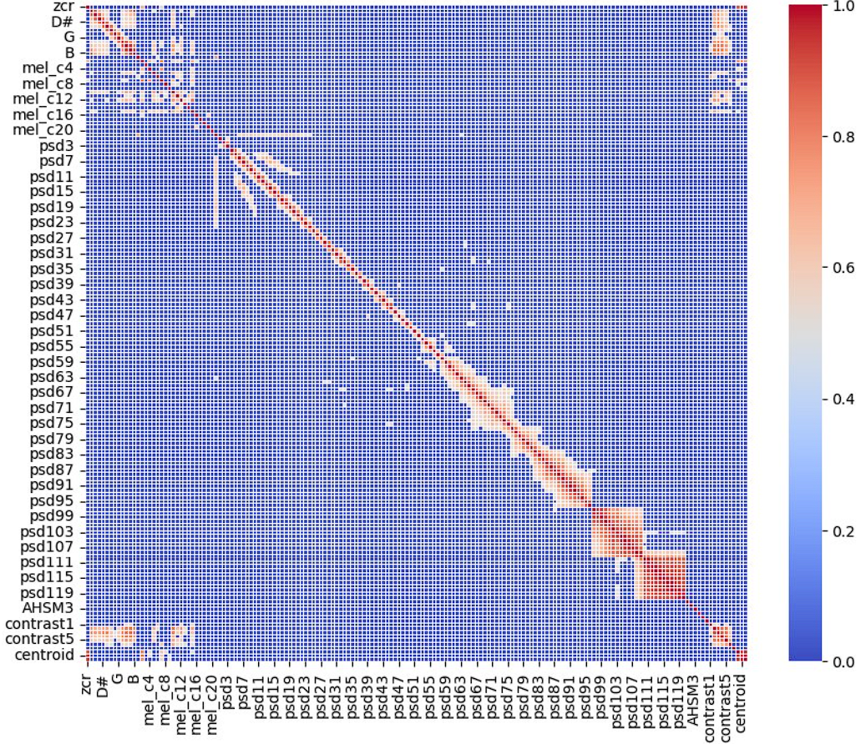
Feature Analysis

Slide 28
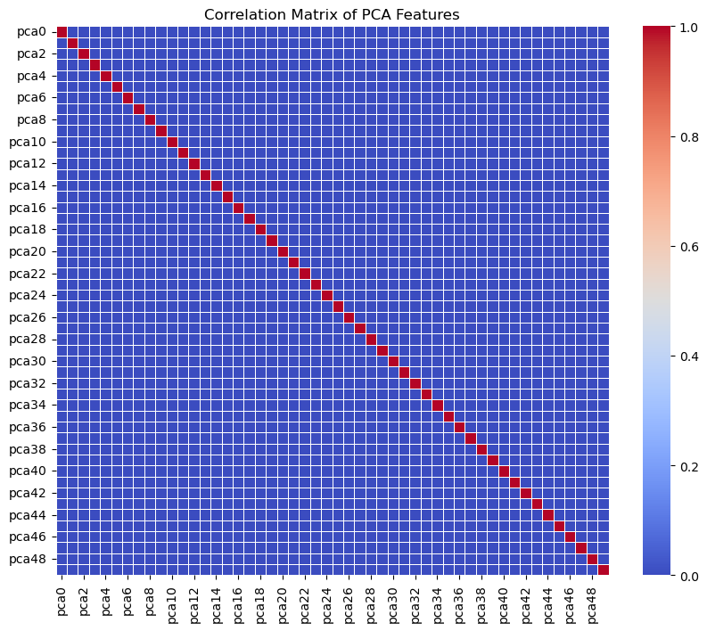
Feature Reduction

Slide 29
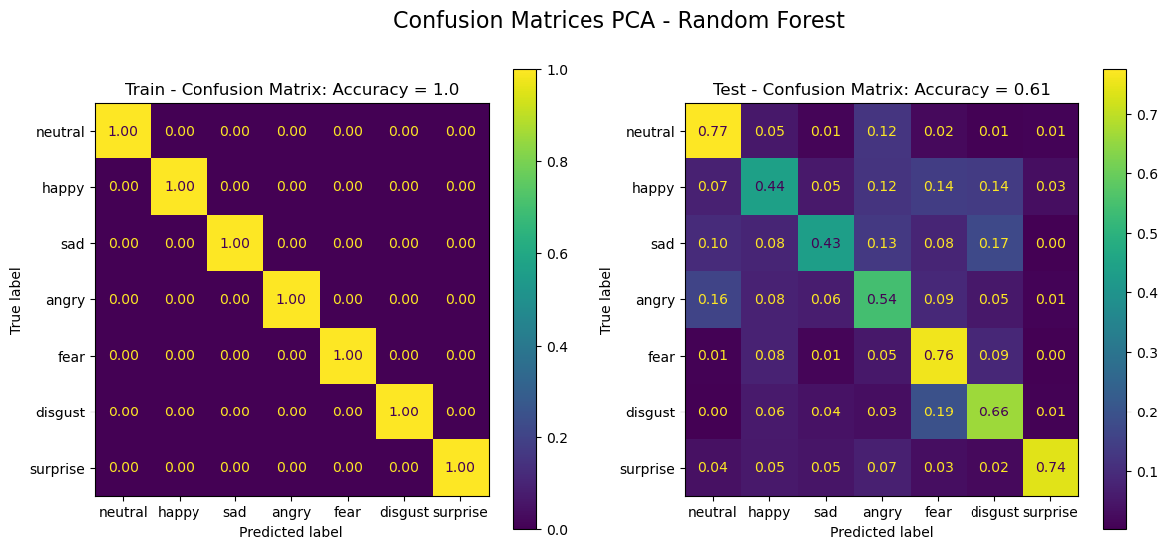
Feature Selection
Accuracy before PCA with Random Forest classifier (384 features): 0.6
After using PCA for dimensional reduction (50 features): 0.61

Slide 30
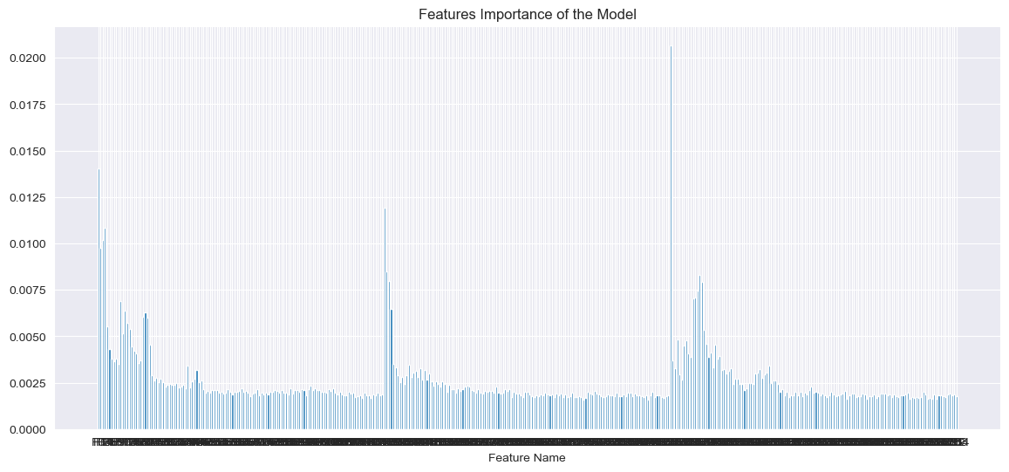
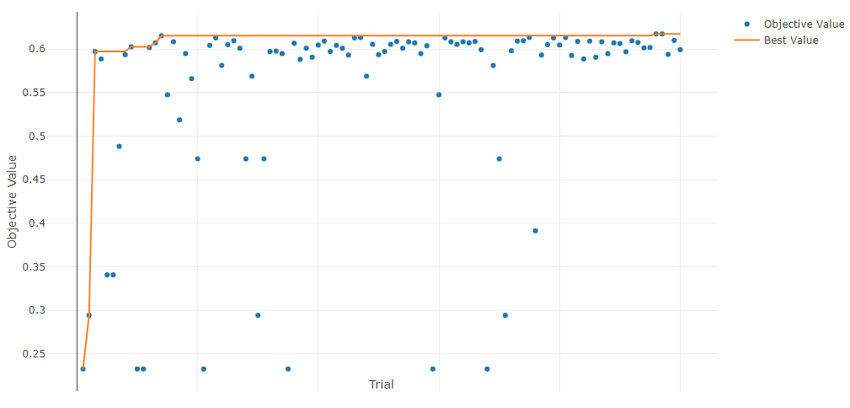
Feature Selection – By Feature Importance
Selecting features by feature importance Threshold, by taking all features with importance values above given Threshold:
Added a random values feature to existing 384 features
Train the RandomForest Classifier and extract its feature importance values
The feature importance value of the random feature was set as a minimum Threshold
The maximum Threshold is set to maximum value of feature importance
Run Optuna framework for choosing the best Threshold, that gives best score with selected features
This method reduces the number of features from 384 to 76, and also increases the score value from 59.52% to 61.73%
Maximum Threshold
Selected Threshold
Minimum Threshold
The last feature is a random created feature
Best score: 0.6173448417591451 (n_feat: 76, threshold: {'thr': 0.0028166328711526807})

Slide 31
Feature Selection - RFECV
Given an estimator that assigns weights to features the goal is to recursively eliminate features.
We used RidgeClassifier as an estimator, and StratifiedKFold for cv.
We got 50 features out of 200K features.

Slide 32
Classifiers

Slide 33
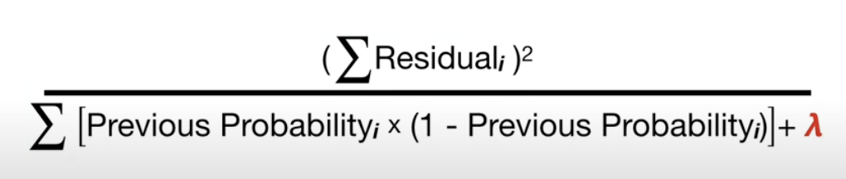
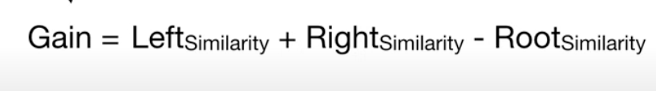
XGBoost
We Have a primary prediction.
We Create branches by thresholding the data.
Each leaf gets a similarity score:
For each leaf we calculate the gain:
The threshold with maximum gain starts the branch.

Slide 34
XGBoost
Prune the tree – getting only the leaves we want
Select only leaves with gain - > 0
After pruning the tree we re-calculate the new residual by: previous prediction + (learning rate * output).
We have parameters to control the model:
Learning rate (eta), gamma, max_depth, lambda, max_leaves
When running all features using XGBClassifier we got 61% accuracy.

Slide 35
Models Search
We use Optuna library as a main model search framework, with different hyperparameters
Cross validation with StratifiedKFolds was used in these search processes
Each model has its own searching process

Slide 36
Results

Slide 37
Classifiers comparison
 | Pros | Cons | Accuracy
SVM | Efficient in high-dimensional spaces and Memory usage | Slow training time, sensitive to parameter tuning & noise | 30%
Random Forest | High accuracy, efficient with large datasets, Robust to overfitting | Black box, Slower prediction time | 61%
Gradient Boosting Machine | High accuracy, can handle mixed data types and imbalanced data | Sensitive to overfitting, Longer training time, hard to interpret | 59%
XGB Classifier | Speed, regularization, | Complexity, tends to overfit | 61%

Slide 38

Conclusion
We found RandomForest, Gradient Boosting, XGBoost classifies has higher score results, and our favorite is RandomForest model, as we predicted
We did not get our target score 70-80%, but we still got as good result 61.7% as best in Kaggle

Slide 39
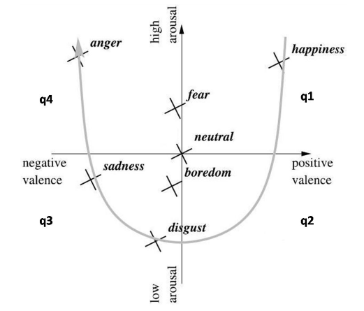
Further work
Add weights and penalty to the model class labels
Recognize features pattern of each emotion class, instead of extracting Mean/Min/Max
Train for probability prediction, like Logistic Regression, for statistical class suggestion
Use unsupervised methods for better understanding the classes grouping
Predict another high-level features as an input to a main training model
Better understanding of XGBoost and its many parameters for better results.

Slide 40

Questions ?

